Slide 1

David M. Kroenke and David J. Auer Database Processing: Fundamentals, Design, and Implementation
Chapter Two:
Introduction to Structured Query Language

Slide 2
Business Intelligence (BI) Systems
Business intelligence (BI) systems are information systems that assist managers and other professionals:
Assessment
Analysis
Planning
Control

Slide 3
Ad-Hoc Queries
Ad-hoc queries:
Questions that can be answered using database data
Example: “How many customers in Portland, Oregon, bought our green baseball cap?”
Created by the user as needed, instead of programmed into an application
Common in business

Slide 4
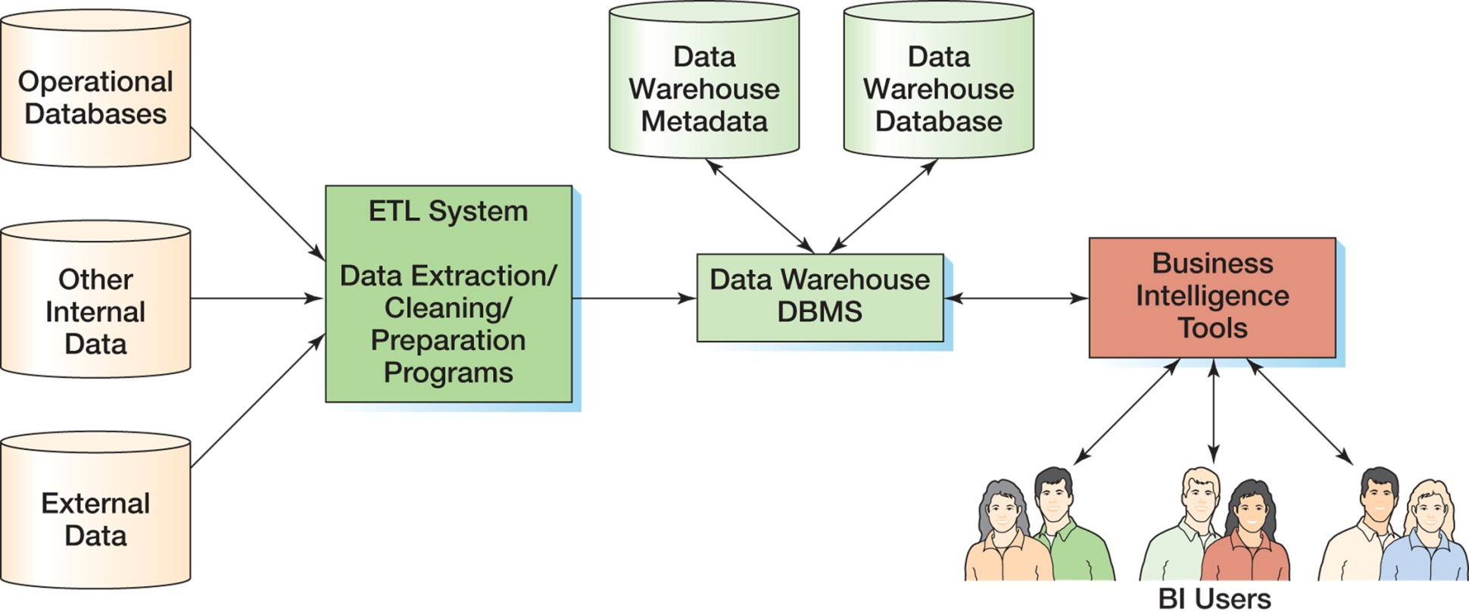
Components of a Data Warehouse

Slide 5
Structured Query Language
Structured Query Language (SQL) was developed by the IBM Corporation in the late 1970’s.
SQL was endorsed as a U.S. national standard by the American National Standards Institute (ANSI) in 1992 [SQL-92].
Newer versions exist, and they incorporate XML and some object-oriented concepts.

Slide 6
SQL As a Data Sublanguage
SQL is not a full featured programming language.
C, C#, Java
SQL is a data sublanguage for creating and processing database data and metadata.
SQL is ubiquitous in enterprise-class DBMS products.
SQL programming is a critical skill.

Slide 7
SQL DDL, DML, and SQL/PSM
SQL statements can be divided into three categories:
Data definition language (DDL) statements
Used for creating tables, relationships, and other structures
Data manipulation language (DML) statements
Used for queries and data modification
SQL/Persistent Stored Modules (SQL/PSM) statements
Add procedural programming capabilities
Variables
Control-of-flow statements

Slide 8
SQL TCL/DCL
Transaction control language (TCL) statements
Used to mark transaction boundaries and control transaction behavior
Data control language (DCL) statements
Used to grant (or revoke) database permissions to (from) users and groups

Slide 9
Cape Codd Outdoor Sports
Cape Codd Outdoor Sports is a fictitious company based on an actual outdoor retail equipment vendor.
Cape Codd Outdoor Sports:
Has 15 retail stores in the United States and Canada.
Has an online Internet store.
Has a (postal) mail order department.
All retail sales are recorded in an Oracle Database 11g database.

Slide 10
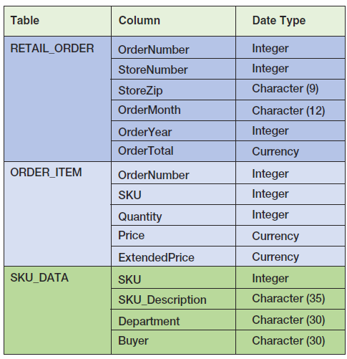
Extracted Retail Sales Data Format

Slide 11
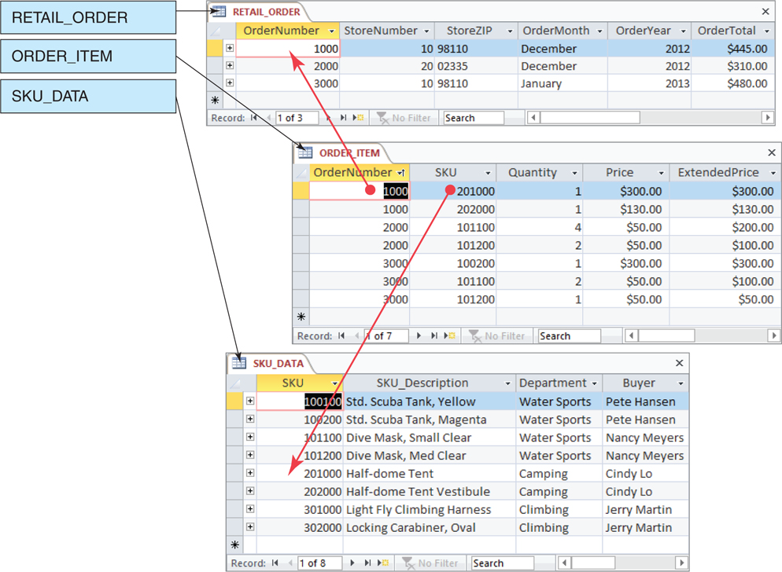
Retail Sales Extract Tables [in Microsoft Access 2010]

Slide 12
The SQL SELECT Statement
The fundamental framework for an SQL query is the SQL SELECT statement.
SELECT {ColumnName(s)}
FROM {TableName(s)}
WHERE {Condition(s)}
All SQL statements end with a semi-colon (;).

Slide 13
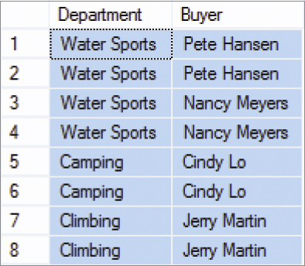
Specific Columns on One Table
SELECT Department, Buyer
FROM SKU_DATA;

Slide 14
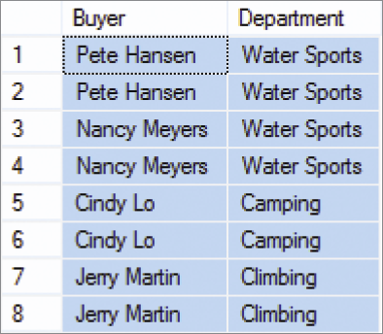
Specifying Column Order
SELECT Buyer, Department
FROM SKU_DATA;

Slide 15
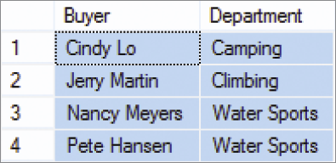
The DISTINCT Keyword
SELECT DISTINCT Buyer, Department
FROM SKU_DATA;

Slide 16
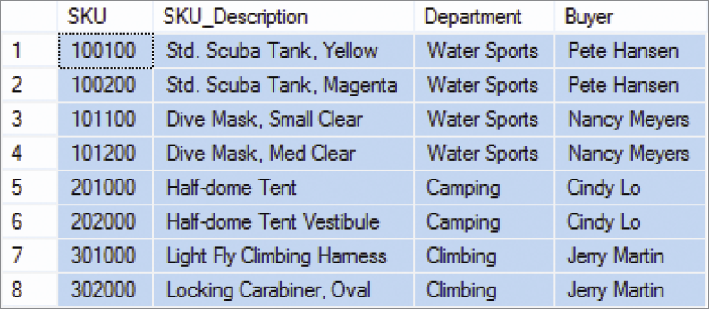
Selecting All Columns: The Asterisk (*) Wildcard Character
SELECT *
FROM SKU_DATA;

Slide 17
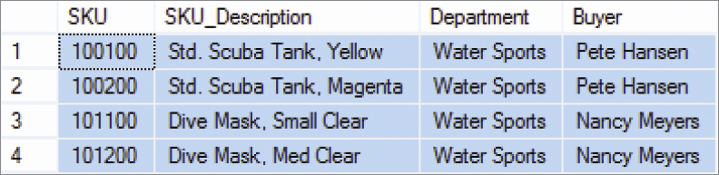
Specific Rows from One Table
SELECT *
FROM SKU_DATA
WHERE Department = 'Water Sports';
NOTE: SQL wants a plain ASCII single quote: ' NOT ‘ !

Slide 18
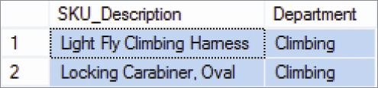
Specific Columns and Rows from One Table
SELECT SKU_Description, Buyer
FROM SKU_DATA
WHERE Department = 'Climbing';

Slide 19
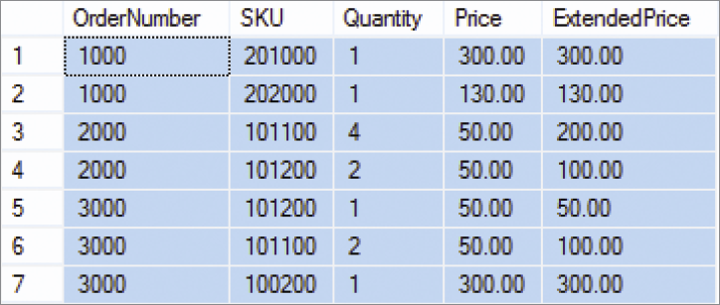
Sorting the Results—ORDER BY
SELECT *
FROM ORDER_ITEM
ORDER BY OrderNumber, Price;

Slide 20
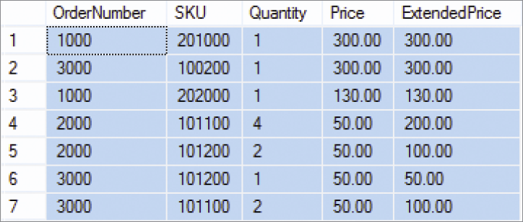
Sort Order: Ascending and Descending
SELECT *
FROM ORDER_ITEM
ORDER BY Price DESC, OrderNumber ASC;
NOTE: The default sort order is ASC—does not have to be specified.

Slide 21
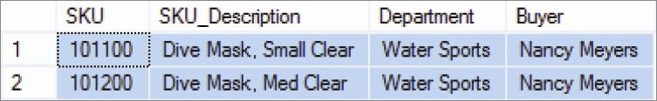
WHERE Clause Options—AND
SELECT *
FROM SKU_DATA
WHERE Department = 'Water Sports'
AND Buyer = 'Nancy Meyers';

Slide 22
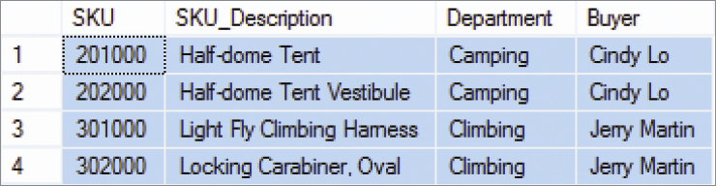
WHERE Clause Options—OR
SELECT *
FROM SKU_DATA
WHERE Department = 'Camping'
OR Department = 'Climbing';

Slide 23
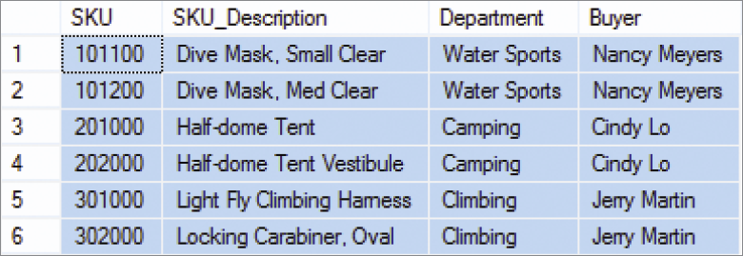
WHERE Clause Options—IN
SELECT *
FROM SKU_DATA
WHERE Buyer IN ('Nancy Meyers',
'Cindy Lo', 'Jerry Martin');

Slide 24
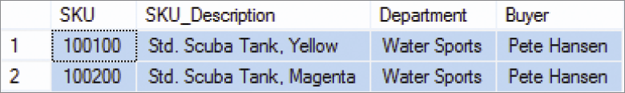
WHERE Clause Options—NOT IN
SELECT *
FROM SKU_DATA
WHERE Buyer NOT IN ('Nancy Meyers',
'Cindy Lo', 'Jerry Martin');

Slide 25
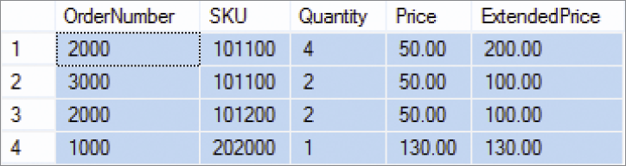
WHERE Clause Options—Ranges with BETWEEN
SELECT *
FROM ORDER_ITEM
WHERE ExtendedPrice
BETWEEN 100 AND 200;

Slide 26
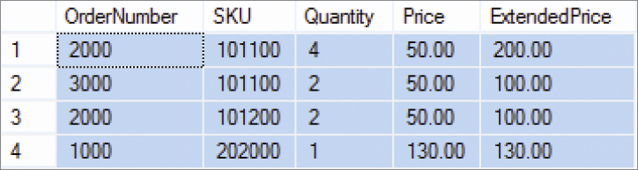
WHERE Clause Options—Ranges with Math Symbols
SELECT *
FROM ORDER_ITEM
WHERE ExtendedPrice >= 100
AND ExtendedPrice <= 200;

Slide 27
WHERE Clause Options— LIKE and Wildcards I
The SQL keyword LIKE can be combined with wildcard symbols:
SQL 92 Standard (SQL Server, MySQL, etc.):
_ = exactly one character
% = any set of one or more characters
Microsoft Access (based on MS DOS)
? = exactly one character
* = any set of one or more characters

Slide 28
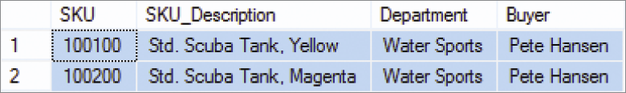
WHERE Clause Options— LIKE and Wildcards II
SELECT *
FROM SKU_DATA
WHERE Buyer LIKE 'Pete%';

Slide 29
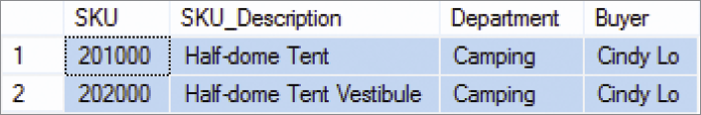
WHERE Clause Options— LIKE and Wildcards III
SELECT *
FROM SKU_DATA
WHERE Buyer LIKE '%Tent%';

Slide 30
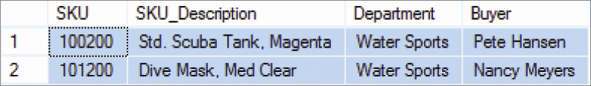
WHERE Clause Options— LIKE and Wildcards IV
SELECT *
FROM SKU_DATA
WHERE SKU LIKE '%2__';

Slide 31
SQL Built-In Functions I
There are five SQL built-in functions:
COUNT
SUM
AVG
MIN
MAX

Slide 32

SQL Built-In Functions II
SELECT SUM(ExtendedPrice)
AS Order3000Sum
FROM ORDER_ITEM
WHERE OrderNumber = 3000;

Slide 33

SQL Built-In Functions III
SELECT SUM(ExtendedPrice) AS OrderItemSum,
AVG(ExtendedPrice) AS OrderItemAvg,
MIN(ExtendedPrice) AS OrderItemMin,
MAX(ExtendedPrice) AS OrderItemMax
FROM ORDER_ITEM;

Slide 34

SQL Built-In Functions IV
SELECT COUNT(*) AS NumberOfRows
FROM ORDER_ITEM;

Slide 35

SQL Built-In Functions V
SELECT COUNT
(DISTINCT Department)
AS DeptCount
FROM SKU_DATA;

Slide 36
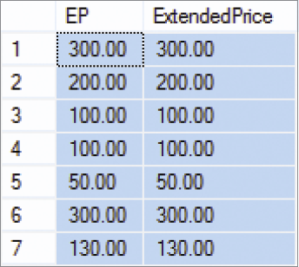
Arithmetic in SELECT Statements
SELECT Quantity * Price AS EP,
ExtendedPrice
FROM ORDER_ITEM;

Slide 37
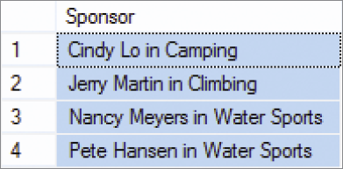
String Functions in SELECT Statements
SELECT DISTINCT RTRIM (Buyer)
+ ' in ' + RTRIM (Department) AS Sponsor
FROM SKU_DATA;
RTRIM used in SQL Server 2012 syntax - Returns a character string after truncating all trailing blanks.

Slide 38
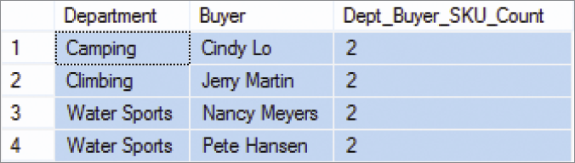
The SQL Keyword GROUP BY I
SELECT Department, Buyer,
COUNT(*) AS
Dept_Buyer_SKU_Count
FROM SKU_DATA
GROUP BY Department, Buyer;

Slide 39
The SQL Keyword GROUP BY II
In general, place WHERE before GROUP BY. Some DBMS products do not require that placement; but to be safe, always put WHERE before GROUP BY.
The HAVING operator restricts the groups that are presented in the result.
There is an ambiguity in statements that include both WHERE and HAVING clauses. The results can vary, so to eliminate this ambiguity SQL always applies WHERE before HAVING.

Slide 40

The SQL Keyword GROUP BY III
SELECT Department, COUNT(*) AS
Dept_SKU_Count
FROM SKU_DATA
WHERE SKU <> 302000
GROUP BY Department
ORDER BY Dept_SKU_Count;

Slide 41
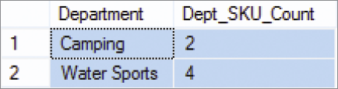
The SQL Keyword GROUP BY IV
SELECT Department, COUNT(*) AS
Dept_SKU_Count
FROM SKU_DATA
WHERE SKU <> 302000
GROUP BY Department
HAVING COUNT (*) > 1
ORDER BY Dept_SKU_Count;

Slide 42

Querying Multiple Tables: Subqueries I
SELECT SUM (ExtendedPrice) AS Revenue
FROM ORDER_ITEM
WHERE SKU IN
(SELECT SKU
FROM SKU_DATA
WHERE Department = 'Water Sports');
Note: The second SELECT statement is a subquery.

Slide 43
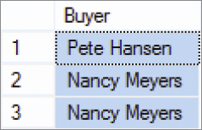
Querying Multiple Tables: Subqueries II
SELECT Buyer
FROM SKU_DATA
WHERE SKU IN
(SELECT SKU
FROM ORDER_ITEM
WHERE OrderNumber IN
(SELECT OrderNumber
FROM RETAIL_ORDER
WHERE OrderMonth = 'January'
AND OrderYear = 2013));

Slide 44
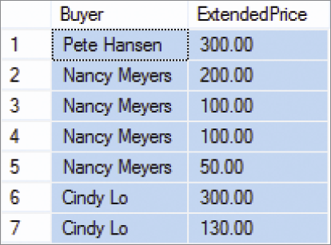
Querying Multiple Tables: Joins I
SELECT Buyer, ExtendedPrice
FROM SKU_DATA, ORDER_ITEM
WHERE SKU_DATA.SKU = ORDER_ITEM.SKU;

Slide 45
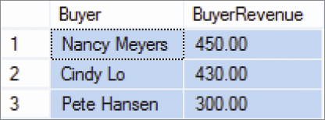
Querying Multiple Tables: Joins II
SELECT Buyer, SUM(ExtendedPrice)
AS BuyerRevenue
FROM SKU_DATA, ORDER_ITEM
WHERE SKU_DATA.SKU = ORDER_ITEM.SKU
GROUP BY Buyer
ORDER BY BuyerRevenue DESC;

Slide 46
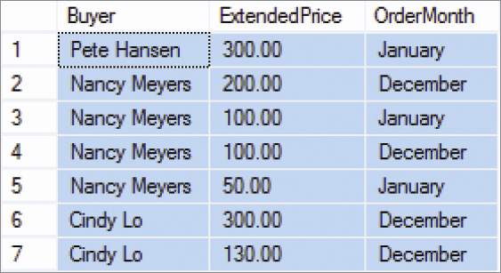
Querying Multiple Tables: Joins III
SELECT Buyer, ExtendedPrice, OrderMonth
FROM SKU_DATA, ORDER_ITEM, RETAIL_ORDER
WHERE SKU_DATA.SKU = ORDER_ITEM.SKU
AND ORDER_ITEM.OrderNumber =
RETAIL_ORDER.OrderNumber;

Slide 47
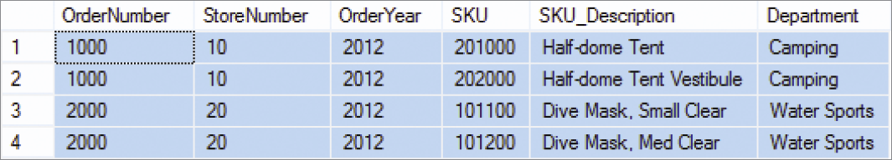
JOIN ON Syntax
SELECT RETAIL_ORDER.OrderNumber, StoreNumber, OrderYear,
ORDER_ITEM.SKU, SKU_Description, Department
FROM RETAIL_ORDER JOIN ORDER_ITEM
ON RETAIL_ORDER.OrderNumber=ORDER_ITEM.OrderNumber
JOIN SKU_DATA
ON ORDER_ITEM.SKU=SKU_DATA.SKU
WHERE OrderYear = '2012'
ORDER BY RETAIL_ORDER.OrderNumber, ORDER_ITEM.SKU;

Slide 48
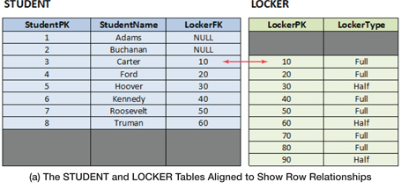
OUTER JOINS I

Slide 49
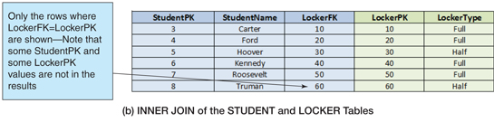
OUTER JOINS II
SELECT…
FROM STUDENT INNER JOIN LOCKER
ON STUDENT.LockerFK = LOCKER.LockerPK
ORDER BY StudentPK;

Slide 50
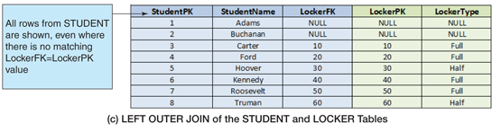
OUTER JOINS III
SELECT…
FROM STUDENT LEFT OUTER JOIN LOCKER
ON STUDENT.LockerFK = LOCKER.LockerPK
ORDER BY StudentPK;

Slide 51
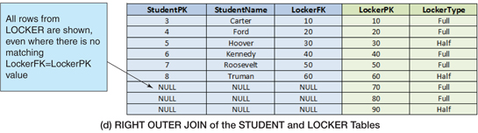
OUTER JOINS IV
SELECT…
FROM STUDENT RIGHT OUTER JOIN LOCKER
ON STUDENT.LockerFK
ORDER BY StudentPK;

Slide 52
Subqueries versus Joins
Subqueries and joins both process multiple tables.
A subquery can only be used to retrieve data from the top table.
A join can be used to obtain data from any number of tables, including the “top table” of the subquery.
In Chapter 7, we will study the correlated subquery. That kind of subquery can do work that is not possible with joins.

